Slide 1

RICHARDSON HOUSING EXPLORATION
Presented By: Daniel Roberts, Khy Logan and Alex Miller

Slide 2


Slide 3
Glimpse of the Raw Data
TOT_VAL | HMSTD_CAP_VAL | REVAL_YR | PREV_REVAL_YR | PREV_MKT_VAL | TOT_CONTRIB_AMT | TAXPAYER_REP | CITY_JURIS_DESC | COUNTY_JURIS_DESC
344920 | 344920 | 2023 | 2022 | 309210 | 0 |  | RICHARDSON | DALLAS COUNTY
479110 | 380891 | 2024 | 2023 | 411820 | 0 |  | RICHARDSON | DALLAS COUNTY
416220 | 395187 | 2024 | 2023 | 418240 | 0 |  | RICHARDSON | DALLAS COUNTY
568770 | 520526 | 2024 | 2023 | 516150 | 0 |  | RICHARDSON | DALLAS COUNTY
542690 | 484000 | 2024 | 2023 | 542690 | 0 |  | RICHARDSON | DALLAS COUNTY
408000 | 347457 | 2024 | 2023 | 365730 | 0 |  | RICHARDSON | DALLAS COUNTY
486900 | 392418 | 2024 | 2023 | 423690 | 0 |  | RICHARDSON | DALLAS COUNTY
302110 | 301884 | 2024 | 2022 | 251570 | 0 |  | RICHARDSON | DALLAS COUNTY
281700 | 267888 | 2024 | 2022 | 223240 | 0 | 849 MORRIS & HOUPT PROPERTY | RICHARDSON | DALLAS COUNTY
321670 | 312048 | 2024 | 2023 | 260040 | 0 | 930 RESOLUTE PROPERTY TAX SOLUTIONS | RICHARDSON | DALLAS COUNTY
282040 | 282040 | 2023 | 2022 | 250000 | 0 |  | RICHARDSON | DALLAS COUNTY
263760 | 206724 | 2024 | 2023 | 212290 | 0 |  | RICHARDSON | DALLAS COUNTY
544770 | 423629 | 2024 | 2023 | 459730 | 0 |  | RICHARDSON | DALLAS COUNTY
558490 | 444420 | 2024 | 2023 | 484960 | 0 |  | RICHARDSON | DALLAS COUNTY
418070 | 418070 | 2024 | 2023 | 363830 | 0 | N98 OCONNOR & ASSOCIATES | RICHARDSON | DALLAS COUNTY
406050 | 401681 | 2024 | 2023 | 374030 | 0 |  | RICHARDSON | DALLAS COUNTY
341640 | 341640 | 2024 | 2023 | 312020 | 0 |  | RICHARDSON | DALLAS COUNTY
793260 | 629333 | 2024 | 2023 | 793260 | 0 |  | RICHARDSON | DALLAS COUNTY
398110 | 252468 | 2024 | 2023 | 398110 | 0 | 458 RAY TAX GROUP | RICHARDSON | DALLAS COUNTY
Rows = 20000
Columns = 107

Slide 4

DATA Clean UP

Slide 5
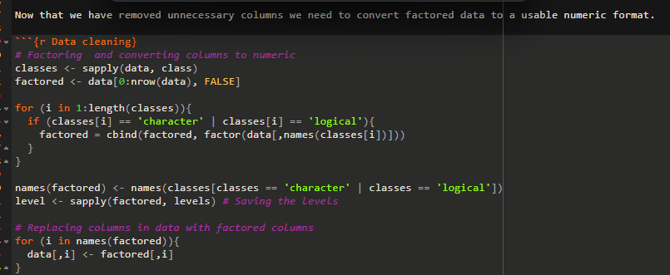
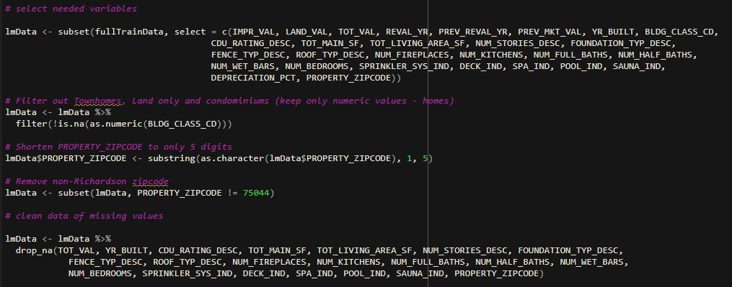
Selecting relevant Columns
Filtering out only Houses
Cleaning up ZipCode (5 digits)
Removing Non-Richardson Zip
Removing Missing Values
Removing Outliers

Slide 6
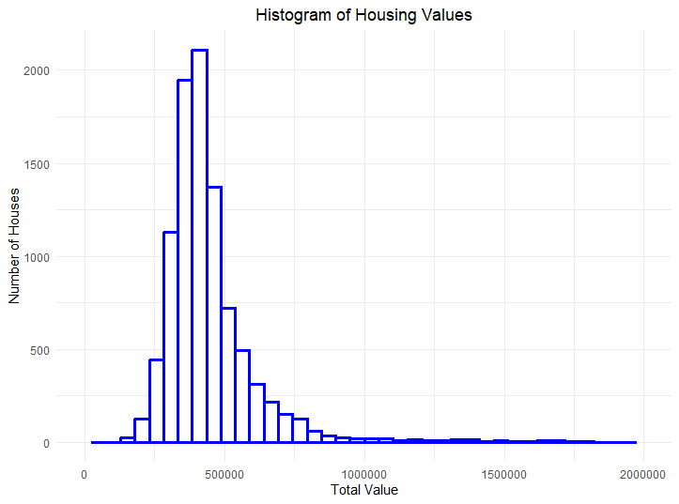
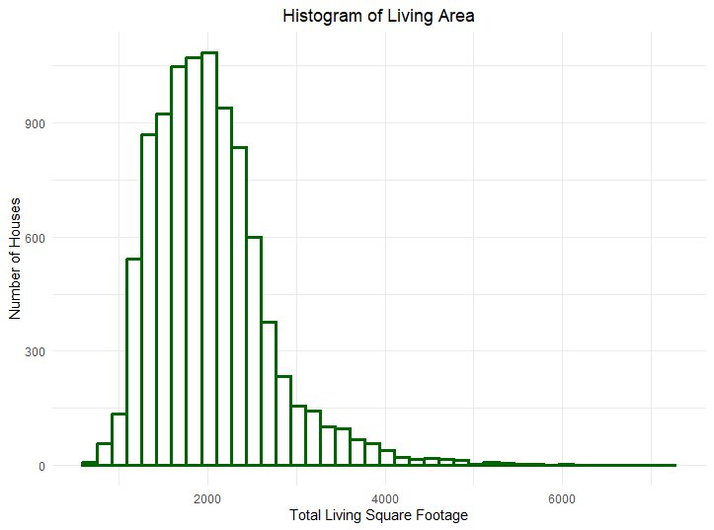
Housing Value and Living Area Histograms

Slide 7
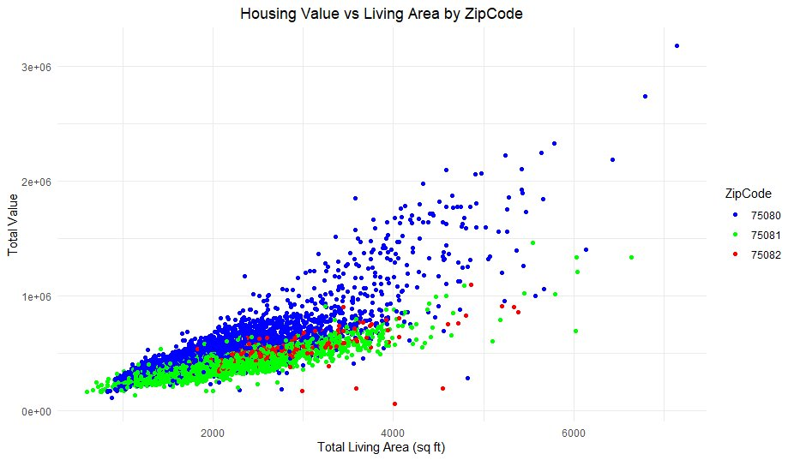
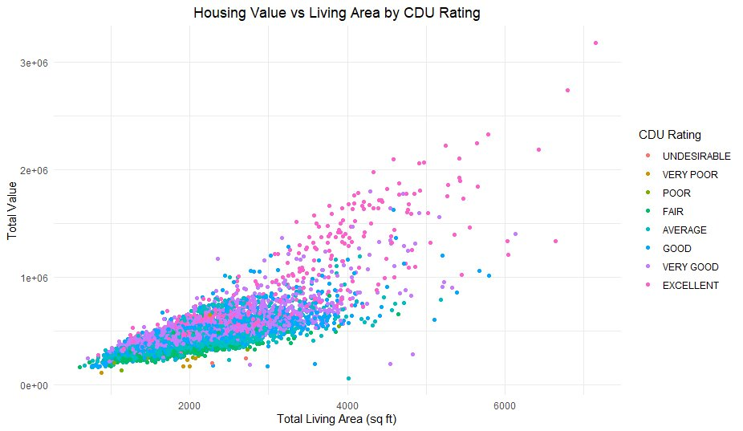
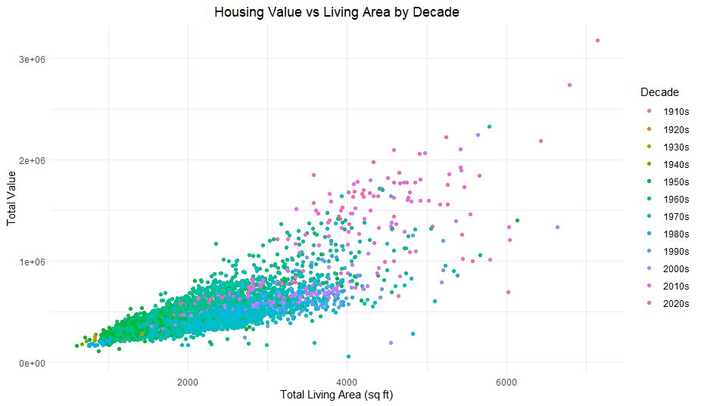
Housing Value vs Living Area Scatter Plots

Slide 8
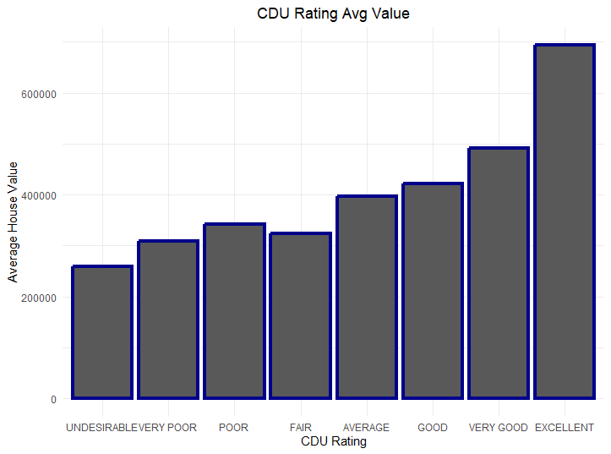

Slide 9
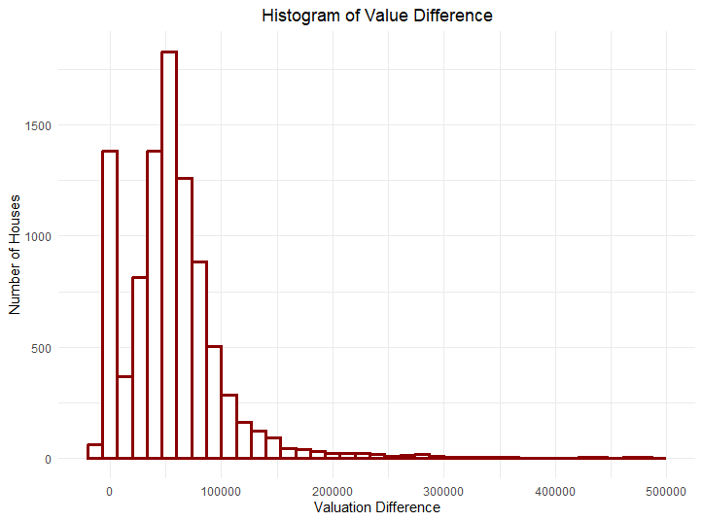
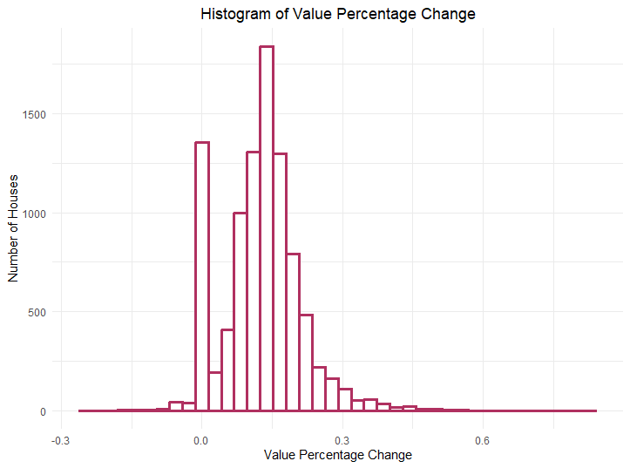

Slide 10
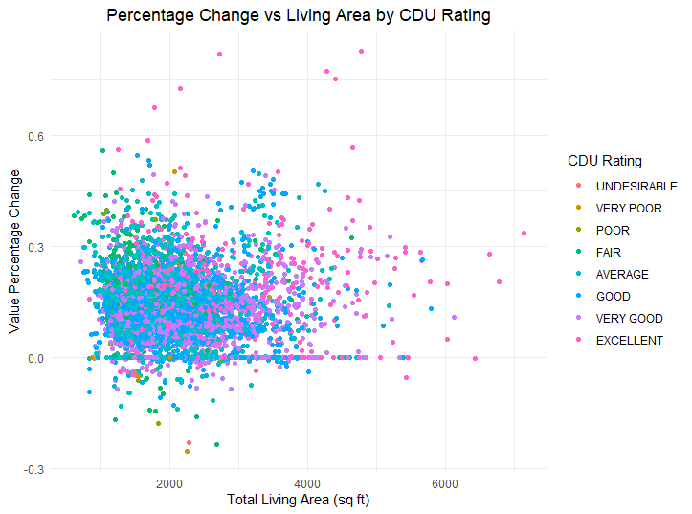
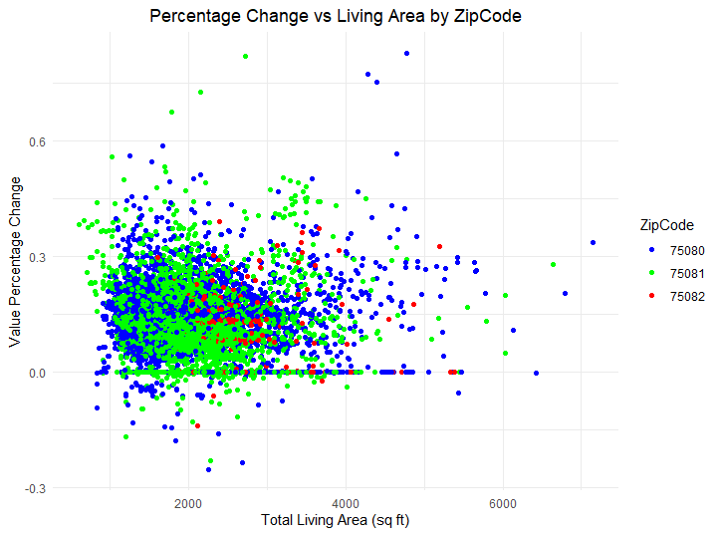
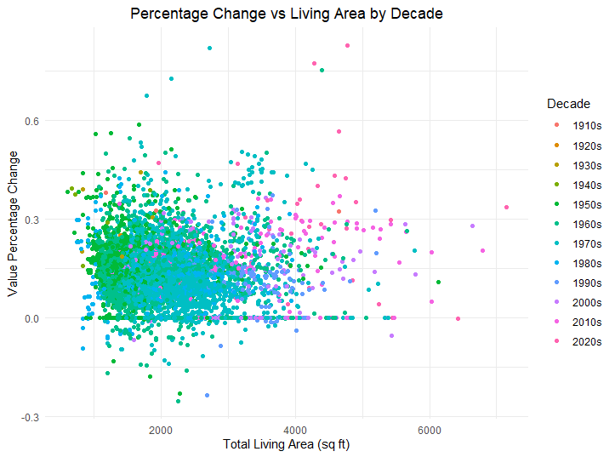
Scatter Plots of Percentage Changes

Slide 11

Linear regression model exploration
$Y= β0$ + β₁x + β₂x + β₃x

Slide 12
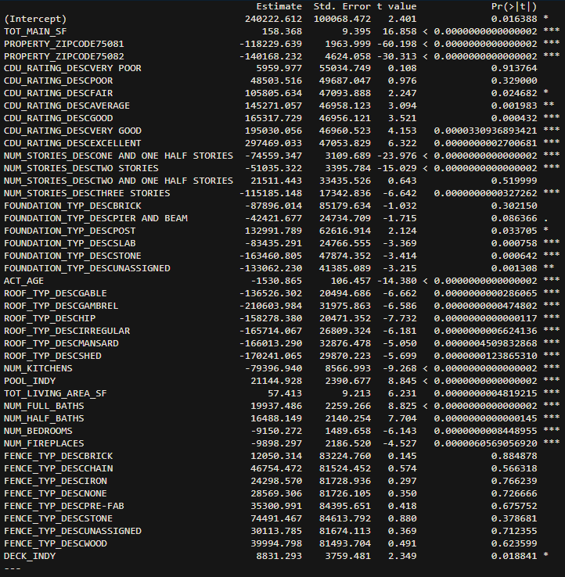
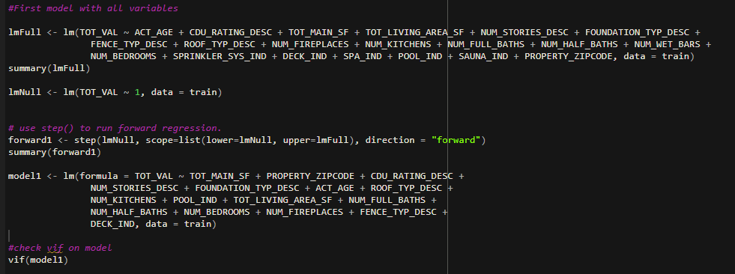
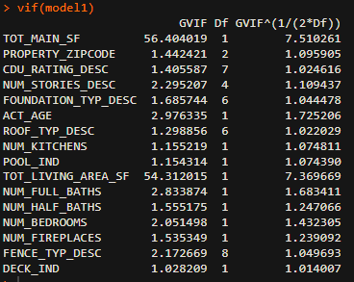



First Linear Model with some Problems

Slide 13
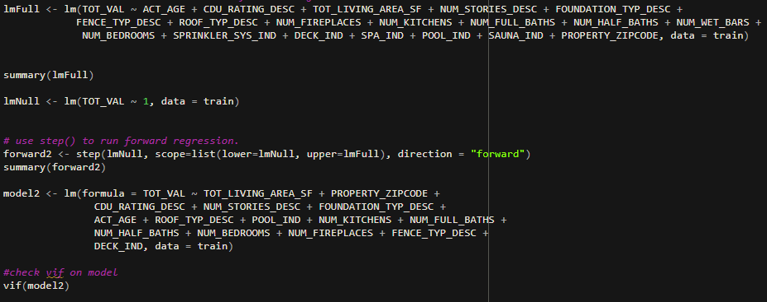
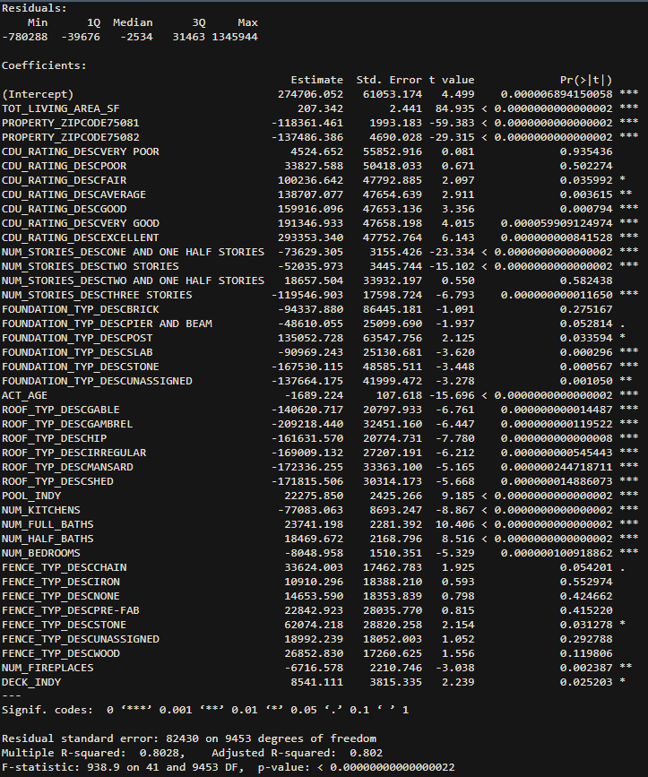
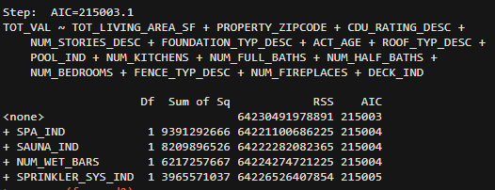
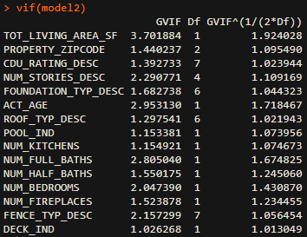

Second Model – Stepwise Forward Regression

Slide 14
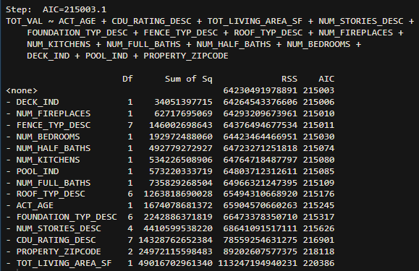
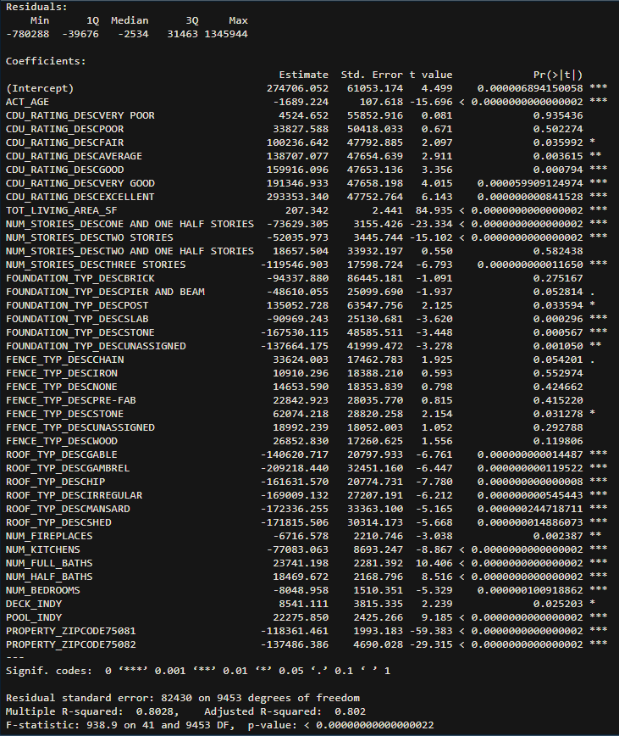
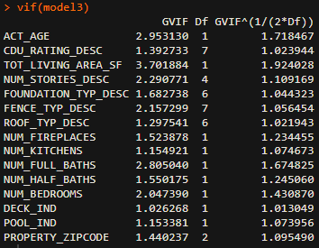

Third
Model -Stepwise Regression Backwards

Slide 15
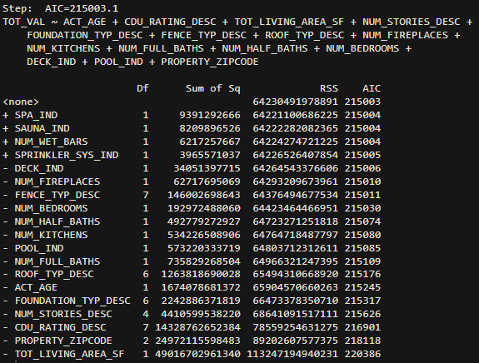
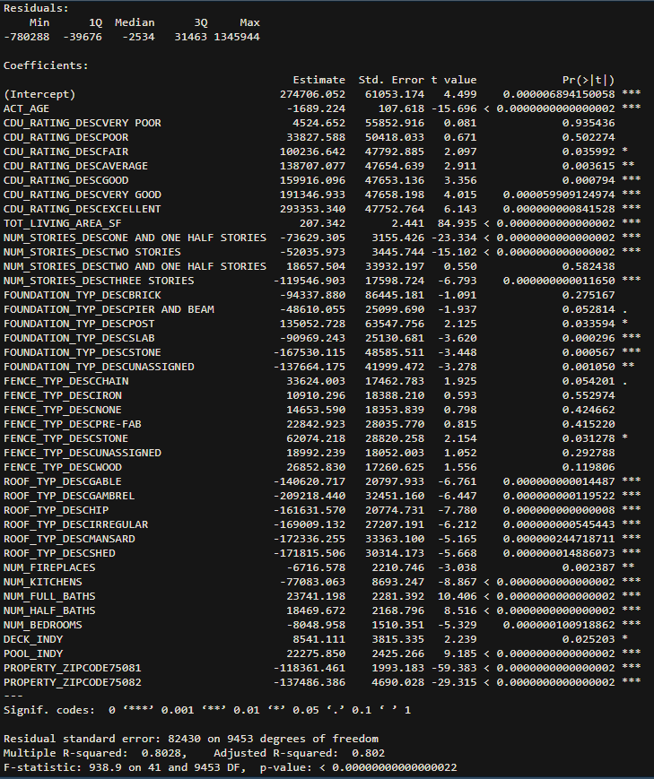
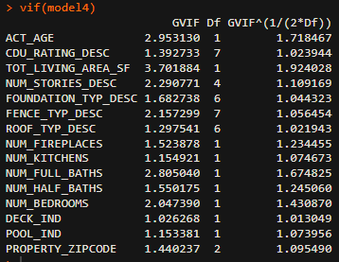

Fourth
Model –
Stepwise Regression Backwards

Slide 16
Evaluating The Stepwise Regressions
All Models ended with the same variables
Coefficients seem to be intuitive
Adding more levels and/or rooms reduces the price
Levels off the increase from square footage
Some P-values are not significant
CDU RATING – “VERY POOR” & “POOR”
NUMBER STORIES – “TWO AND ONE HALF”
FOUNDATION TYPE – “BRICK”
FENCE TYPE – SEVERAL
Accuracy seems decent on validation

Slide 17
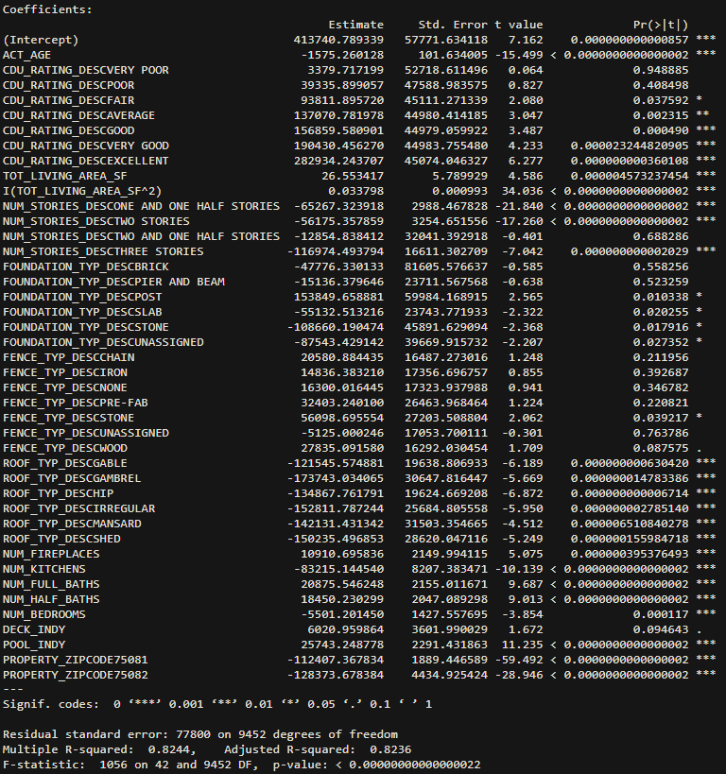
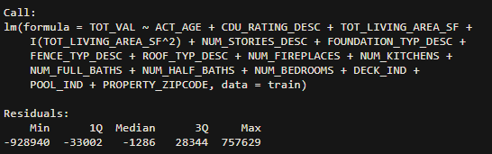

Fifth Model – Polynomial Regression
Slight Improvement on Accuracy
Most Values are Similar
Two and One Half Stories changed from positive to negative
Polynomial not necessarily needed in this Dataset

Slide 18
CDU Rating Prediction
Classification Tree

Slide 19
CDU Rating Background
Condition, Desirability, Utility
Excellent - Building is in perfect condition; very attractive and highly desirable
Very Good - Slight evidence of deterioration; still attractive and quite desirable.
Good - Minor deterioration visible; slightly less attractive and desirable, but useful.
Average - Normal wear and tear is apparent; average attractiveness and desirability.
Fair - Marked deterioration - but quite usable; rather unattractive and undesirable
Poor - Definite deterioration is obvious; undesirable, and barely usable.
Very - Poor Condition approaches unsoundness; extremely undesirable and barely usable.
Unsound - Building is unsound and practically unfit for use
These categories are determined by an official government assigned appraiser

Slide 20
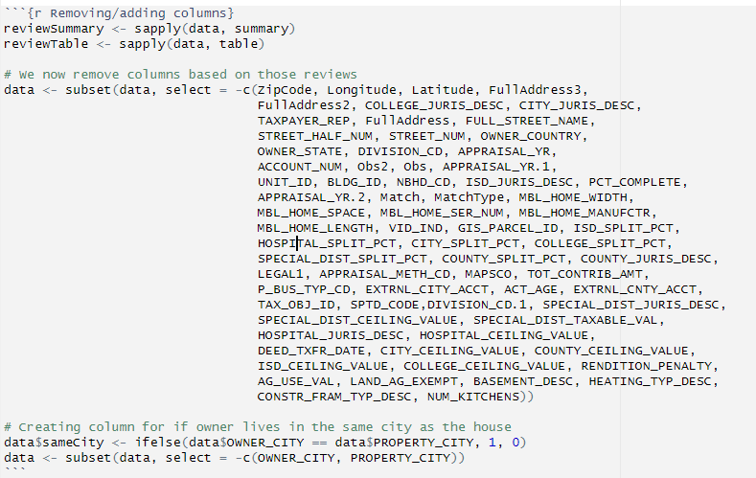
Data Cleaning
Removed columns corresponding to location to prevent these from effecting the model
Reviewed tables of each column to determine if it was mostly null/one value and removed these columns
Created a column that determined if the owner lived in the same city as the property
No rows needed to be removed as all remaining columns had no NA data
Converted categorical and logical columns into usable formats
Notes:
Don’t want rich neighborhoods to all be listed as great but a house right next door that isnt good to get lumped with them. - i.e. Lemmon street in Dallas
Hoped for interesting results from owners not living in the same city as the property, either flippers or multiple home owners

Slide 21
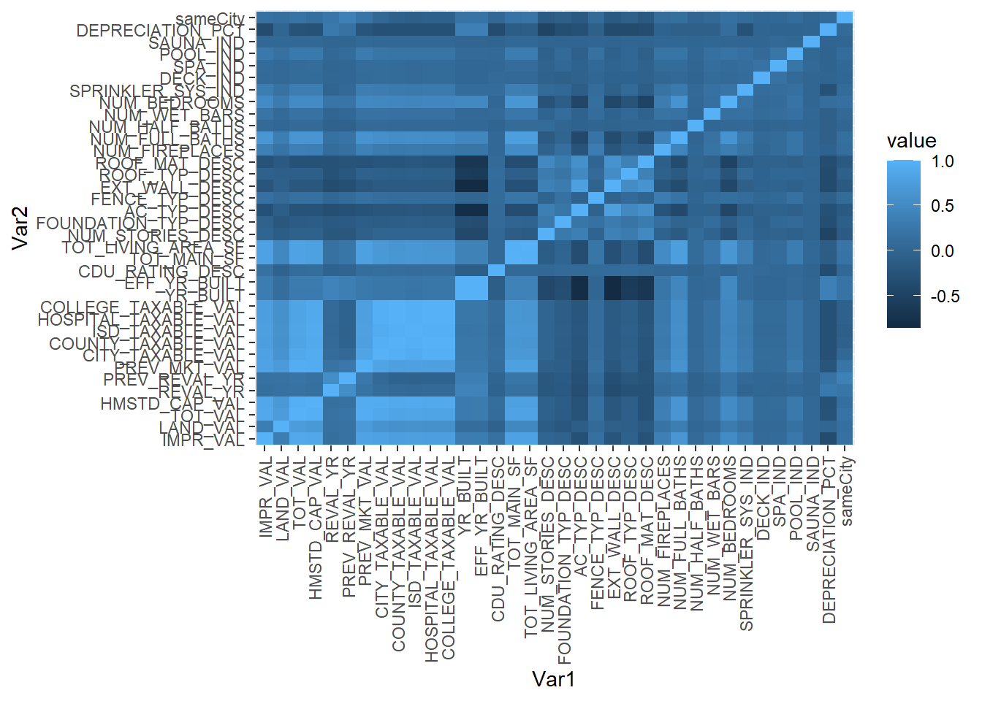
Correlation
Looking deeper into column correlation we can remove several columns due to being overly correlated
For instance, EFF_YR_BUILT and YR_BUILT have a correlation coefficient of 0.9971
After this final round of removals, we are left with 27 predictors and the CDU Rating

Slide 22
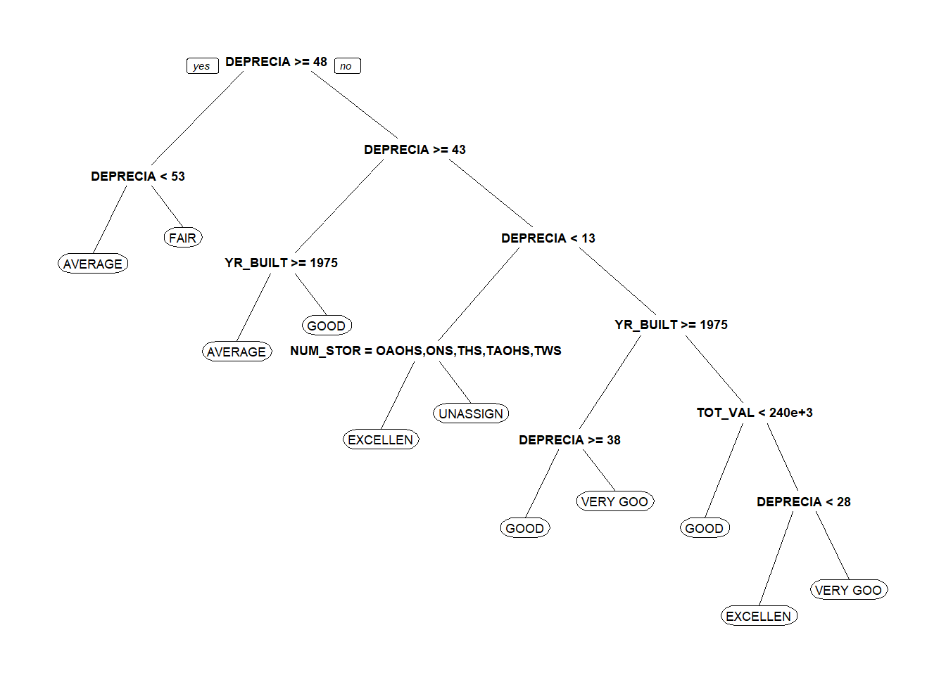
Classification Tree
Standard Error Prune
Cross-Validated SSE Prune
As we see, both methods achieve the same tree so we can evaluate performance.

Slide 23
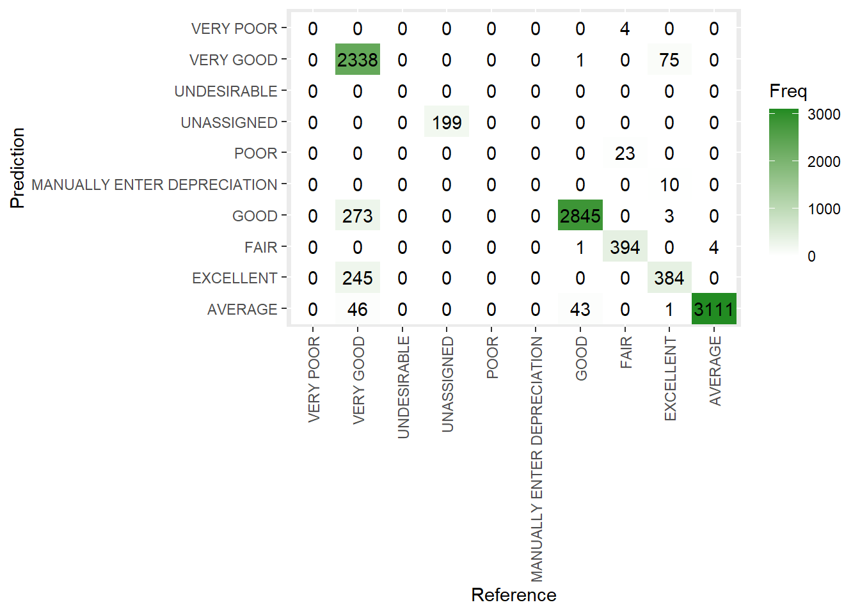
Confusion Matrix
Accuracy: 92.71%
95% CI Accuracy: (0.9218, 0.9321)
P-Value [Acc > NIR] : < 2.2e-16
Despite the high accuracy, this model would most likely not accurately predict Undesirable, Poor, and Very Poor properties due to the low number of properties with these ratings in the data.

Slide 24
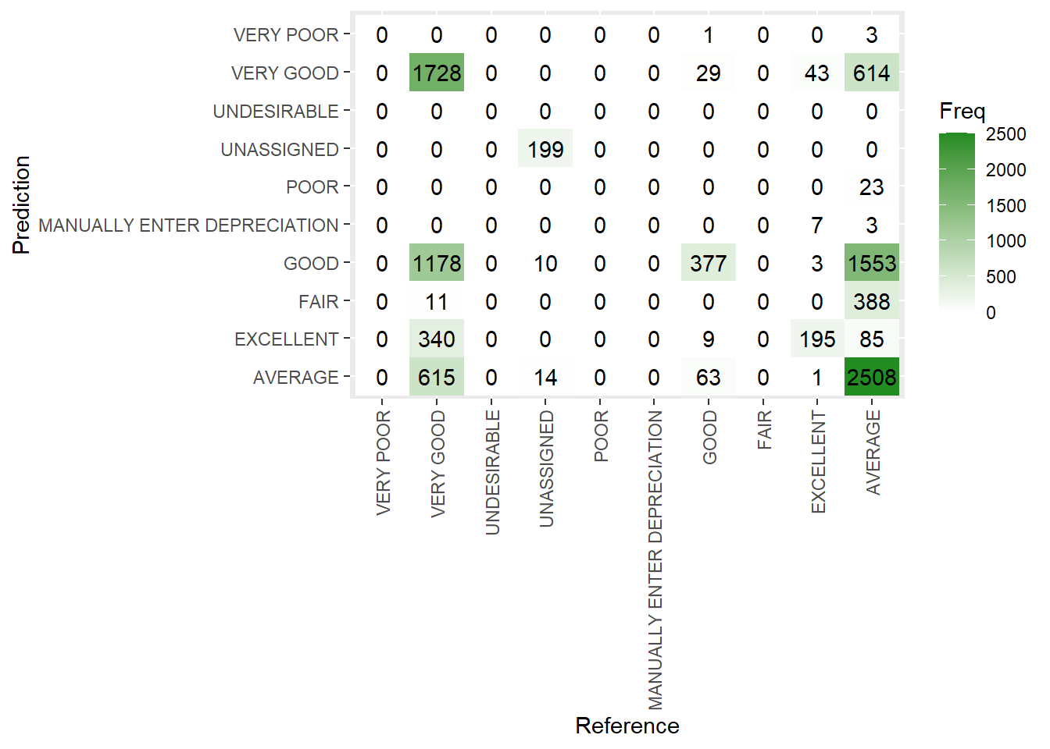
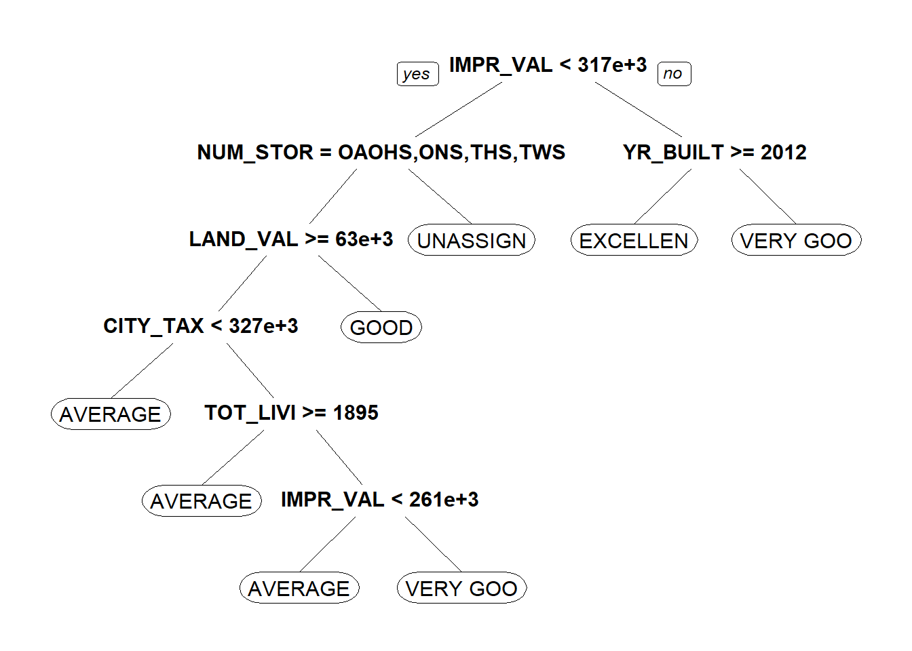
Tree without Depreciation Percent
After seeing that Depreciation Percent accounted for most of the nodes in the previous trees I decided to investigate if this was removed.
Unfortunately, our tree is heavily reliant on this column as seen in the confusion matrix produced after removing this column.
Without using the Depreciation Percent data our overall accuracy drops to an abysmal 50.01%.

Slide 25
Final Thoughts
The initial classification tree did an excellent job predicting the CDU Rating when it comes to the categories that were available.
More research is required to determine why Depreciation Percent had such a significant effect on the tree despite having a lower correlation coefficient with the CDU Rating than other predictors.
If future research is conducted ensuring more Poor and Very Poor data points would be useful.
If a sufficient model is created this would be a great tool in determining what is the best way to increase your home's CDU Rating.

